Slide 1
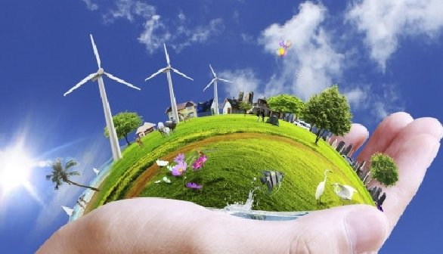
Ch. 20 Biotech

Slide 2
Tools and Techniques
Restriction Enzymes
Gel Electrophoresis
PCR
Vectors/plasmids
Gene Library/Microarray
Stem Cells
DNA sequencing
DNA Cloning
What is it?
What is it used for?
How does it work/what does it do?
  Specifics
Pic

Slide 3
Human Genome Project (HGP)
Francis Collins (NIH) & Jay Craig Ventor (Celera)
1.) HGP = Map of all 30,000 genes on the 46 human chromosomes (1988-2003)
  Information has led to many advances in the fields of medicine, agriculture, bio-engineering
2.) An organism’s genome is the total DNA in the nucleus of each cell
The human genome contains approx 3 billion nucleotide bases
The average gene is made up of 3000 bases, but sizes of genes vary greatly.
The total number of genes is estimated at around 30000.
99.9% nucleotide bases are exactly the same in all people

Slide 4
As of September 2007 the complete sequence was known of,
  1879 viruses,
  577 bacterial species, and
  roughly 23 eukaryotic species (of which about half are fungi).

Slide 5
GENERAL GENOMIC COMPARISONS
Organism | Genome Size (Bases) | Estimated Genes
Human (Homo sapiens) | 3 billion | 30,000
Laboratory mouse (M. musculus) | 2.6 billion | 30,000
Thale cress (A. thaliana) | 100 million | 25,000
Roundworm (C. elegans) | 97 million | 19,000
Fruit fly (D. melanogaster) | 137 million | 13,000
Yeast (S. cerevisiae) | 12.1 million | 6,000
Bacterium (E. coli) | 4.6 million | 3,200
Human immunodeficiency virus (HIV) | 9700 | 9

Slide 6
Genetic Engineering
Biotechnology refers to technology used to manipulate DNA
The procedures are often referred to as genetic engineering
Recombinant DNA refers to the DNA from the two different organisms
  Can be used for creating transgenic organisms, gene therapy, and cloning
  first used in the 1970’s with bacteria
Gene cloning: process by which scientists can produce multiple copies of specific segments of DNA that they can then work with in the lab
Transformation: bacteria takes up plasmid (w/gene of interest)

Slide 7
Applications of DNA Technology
Diagnosis of disease – identify alleles, viral DNA
Gene therapy – alter afflicted genes
Production of pharmaceuticals
Forensic applications – DNA profiling
Environmental cleanup – use microorganisms
Agricultural applications - GMOs

Slide 8
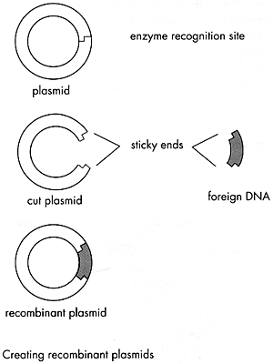

RECOMBINANT DNA Vocab
A plasmid is small ring of DNA in a bacteria
  Contain genes which code for less essential traits (antibiotic resistance)
vector = a DNA molecule used to carry a gene of interest from one organism to another
  Plasmids & viruses are the most commonly used vectors
Restriction Enzyme - cut DNA at specific sequences
  For example, EcoRI always cuts DNA at GAATTC as indicated below

Slide 9
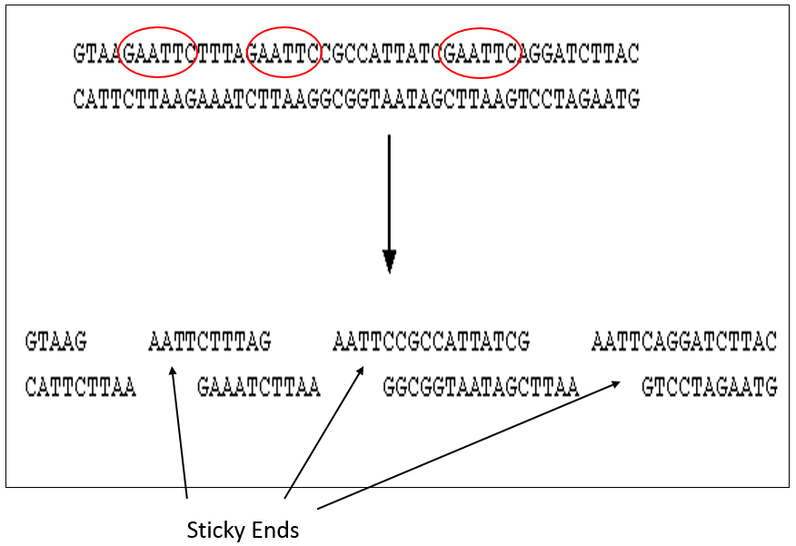
  The sequence GAATTC appear three time in the below strand of DNA, so it is cut into four pieces.
sticky ends - unpaired nucleotide sequences at the end of cut DNA strands

Slide 10
Making Recombinant Bacteria
a.) Cut the Bacterial DNA with “restriction enzymes (RE)”.
b.) Cut the gene of interest from the organism’s DNA with same “restriction enzyme” (RE).
c.) Combine the “sticky ends” of the two DNA pieces together with DNA ligase (enzyme) – also known as gene splicing
d.) Insert vector into bacteria.
e.) The bacteria can now reproduce the recombinant DNA and the foreign genes will be expressed in the bacteria.

Slide 11
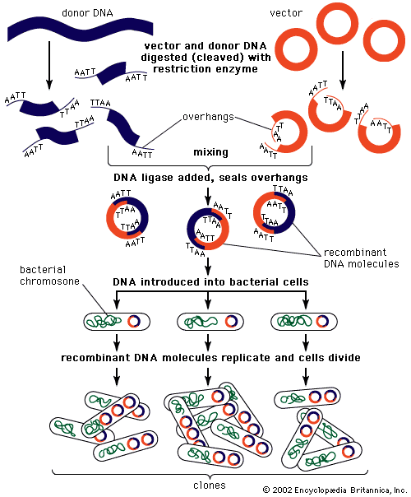
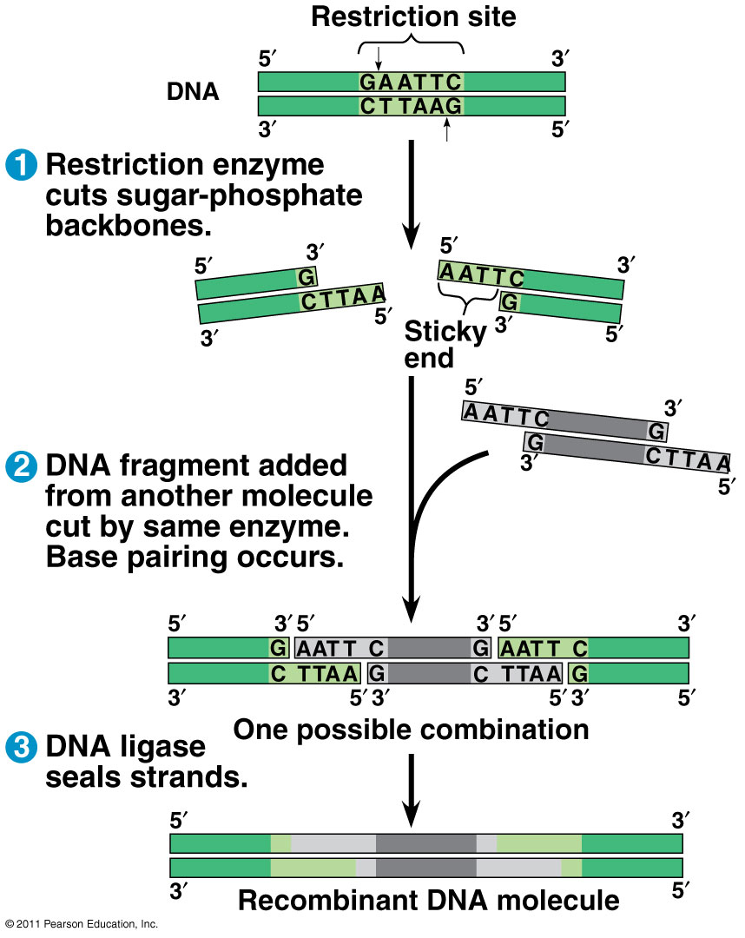

Slide 12
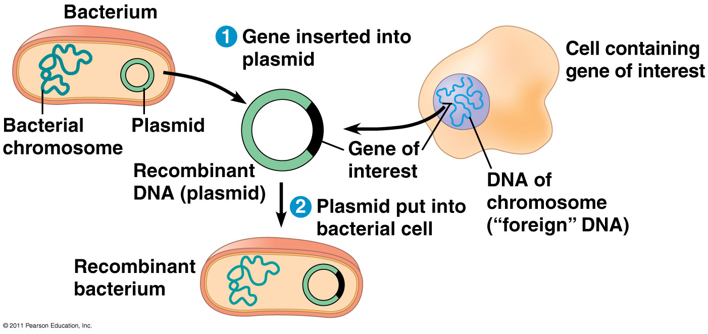
Gene Cloning

Slide 13
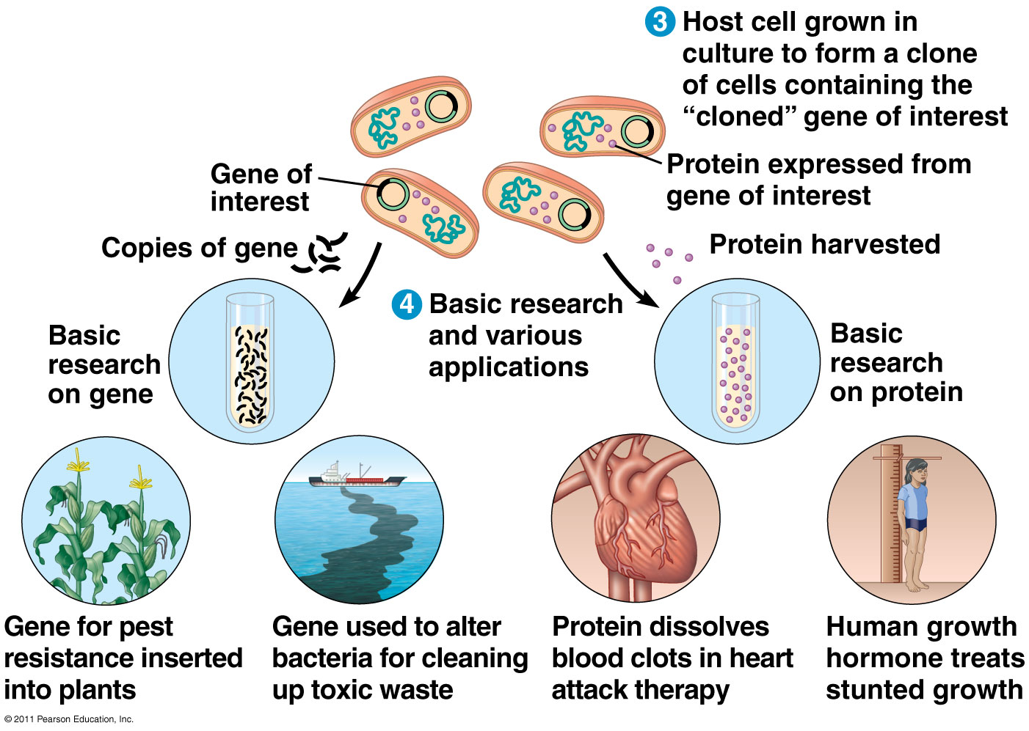
Applications of Gene Cloning

Slide 14
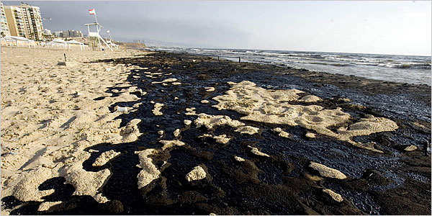
Benefits of Recombinant Bacteria
Bacteria can make human insulin or human growth hormone.
Bacteria can be engineered to “eat” oil spills.

Slide 15
Problems with inserting DNA
Difference between eukaryotic RNA and prokaryotic RNA?
Use reverse transcriptase
  an enzyme that catalyzes the formation of DNA from an RNA template in reverse transcription
Creates complementary DNA (cDNA) which lacks introns
  Can now be inserted into prokaryote

Slide 16
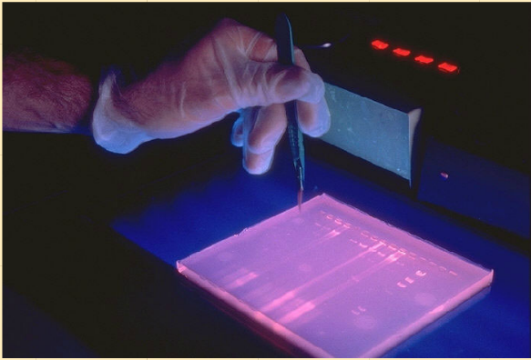
Electrophoresis
Separates fragments of DNA based on their size.
How it works
The DNA is placed in to an agarose gel
The gel is exposed to an electric field
DNA migrates to the positive electrode (DNA is negatively charged)
Different sized fragments move through the gel at different rates (smaller = faster = farther)

Slide 17
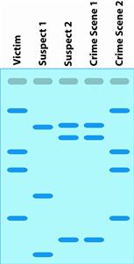
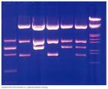
GENETIC ENGINEERING: What Can We Do With Genes?
1. DNA fingerprinting - Analysis of DNA sequences to determine identity

Slide 18
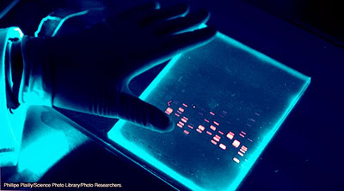
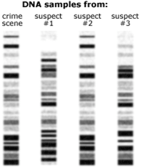

Slide 19
Restriction Fragment Length Polymorphism (RFLPs – rif-lips)
Cut DNA with different restriction enzymes
Each person has different #s of DNA fragments created
Analyze DNA samples on a gel for disease diagnosis
Outdated method of DNA profiling (required a quarter-sized sample of blood)
STR = Short Tandem Repeats
Non-coding DNA has regions with sequences (2-5 base length) that are repeated
Each person has different # of repeats at different locations (loci)
Current method of DNA fingerprinting used – only need 20 cells for analysis

Slide 20
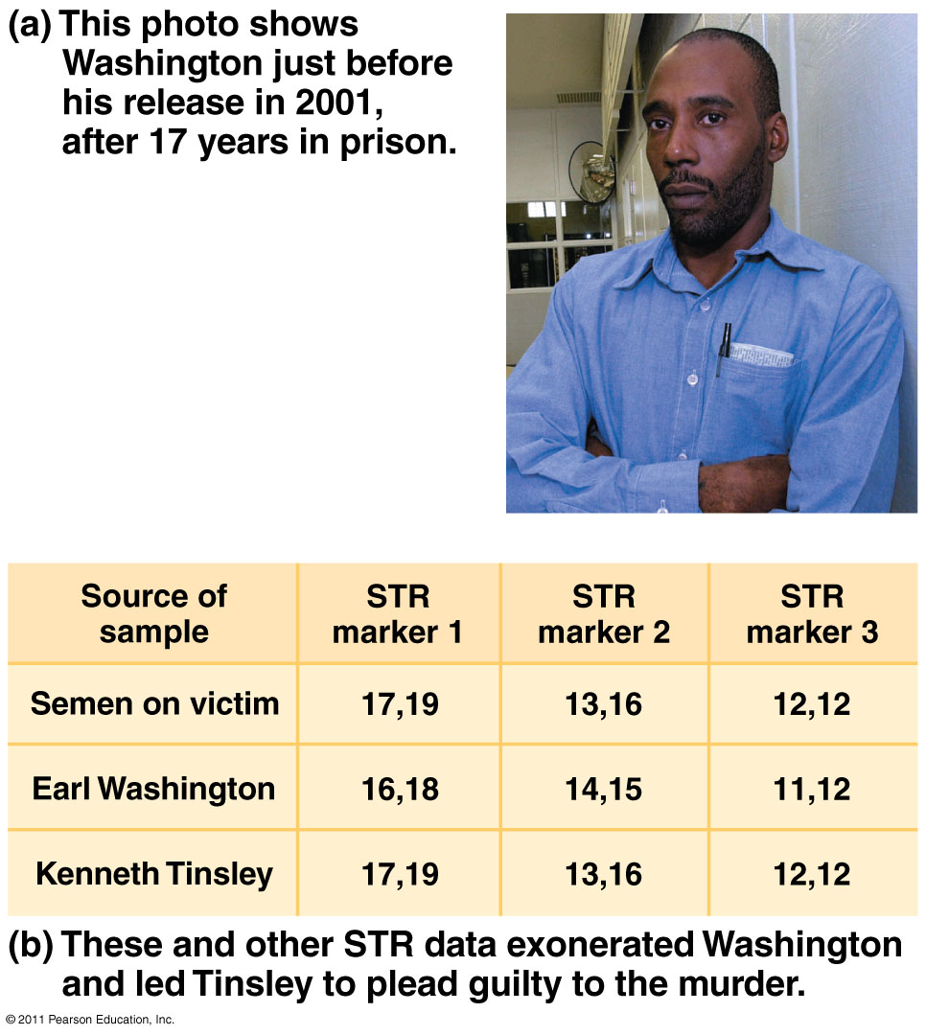
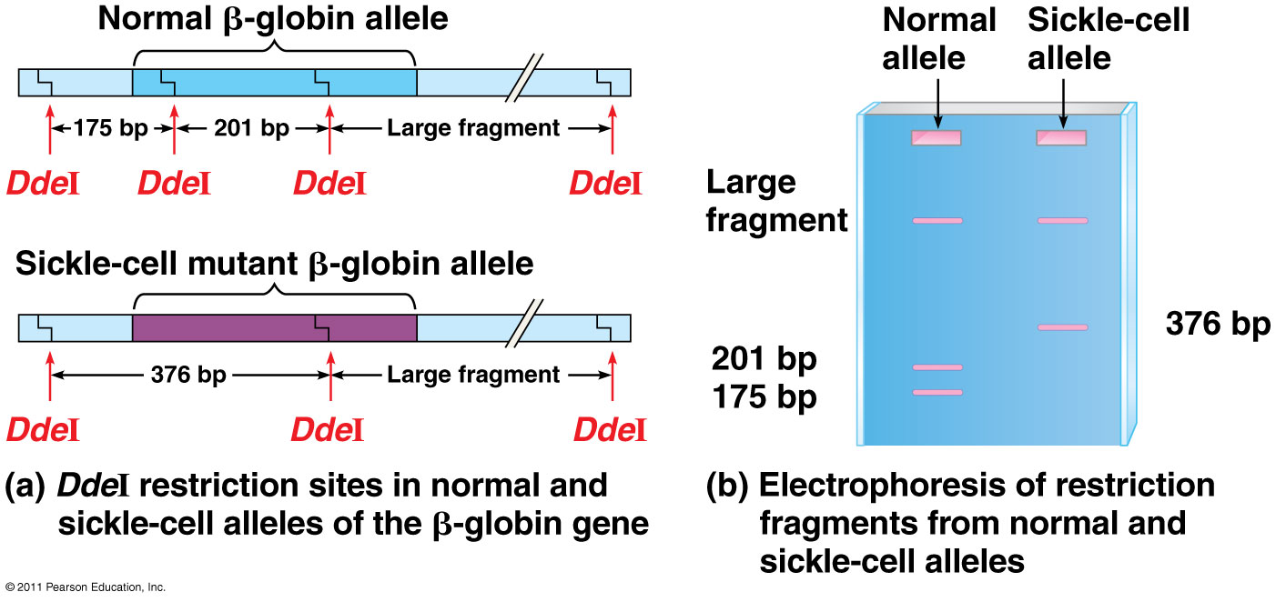

Slide 21
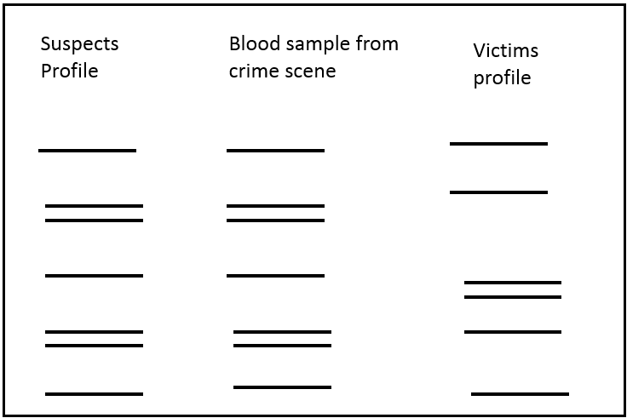
Example
A violent murder occurred.
The forensics team retrieved a blood sample from the crime scene.
They prepared DNA profiles of the blood sample, the victim and a suspect as follows:
Was the suspect at the crime scene?

Slide 22
Solving Medical Problems
Can be used to determine whether a particular person is the parent of a child
A child's paternity (father) and maternity(mother) can be determined
This information can be used in
  Paternity suits
  Inheritance cases
  Immigration cases

Slide 23
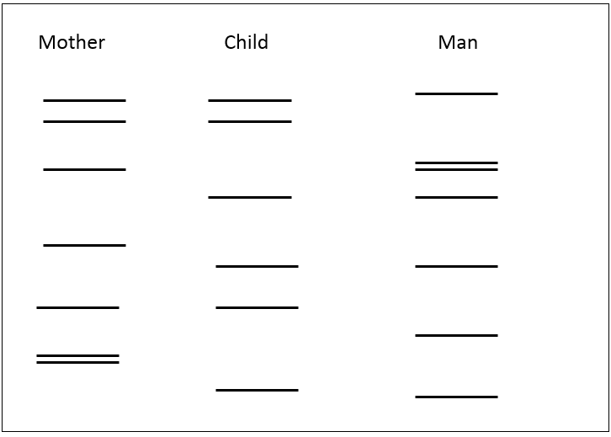
Example: A Paternity Test
Compare the DNA profile of a mother and her child and identify DNA fragments in the child which are absent from the mother must be from the biological father

Slide 24
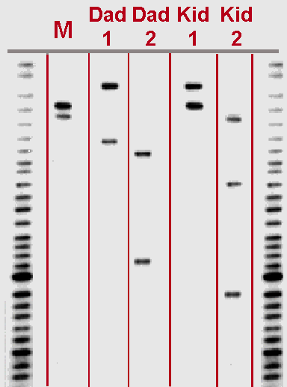

Slide 25
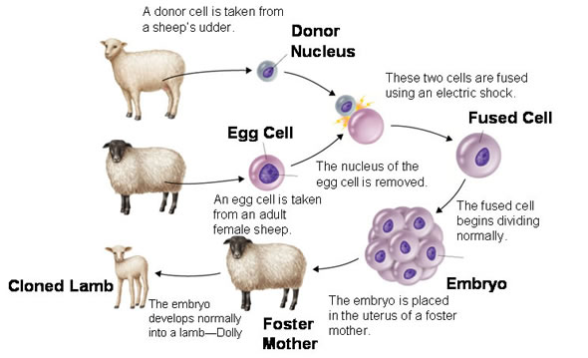

2. Gene therapy: A "normal" gene is inserted into the genome to replace an "abnormal," disease-causing gene
  may be used treat a disorder by inserting a gene instead of using drugs or surgery
Types of gene therapy: Replacing or inactivate a mutated gene that causes disease
3. Cloning – Creating genetically IDENTICAL copies
Ex: Dolly (1996-2003)- it took 276 attempts before successful

Slide 26
4. Stem cells
Stem cells: can reproduce itself indefinitely and produce other specialized cells
  Zygote = totipotent (any type of cell)
  Embryonic stem cells = pluripotent (many cell types)
  Adult stem cells = multipotent (a few cell types) or induced pluripotent, iPS (forced to be pluripotent)
can be used to generate virtually any type of specialized cell in the human body
The goals to study human development and to treat disease

Slide 27
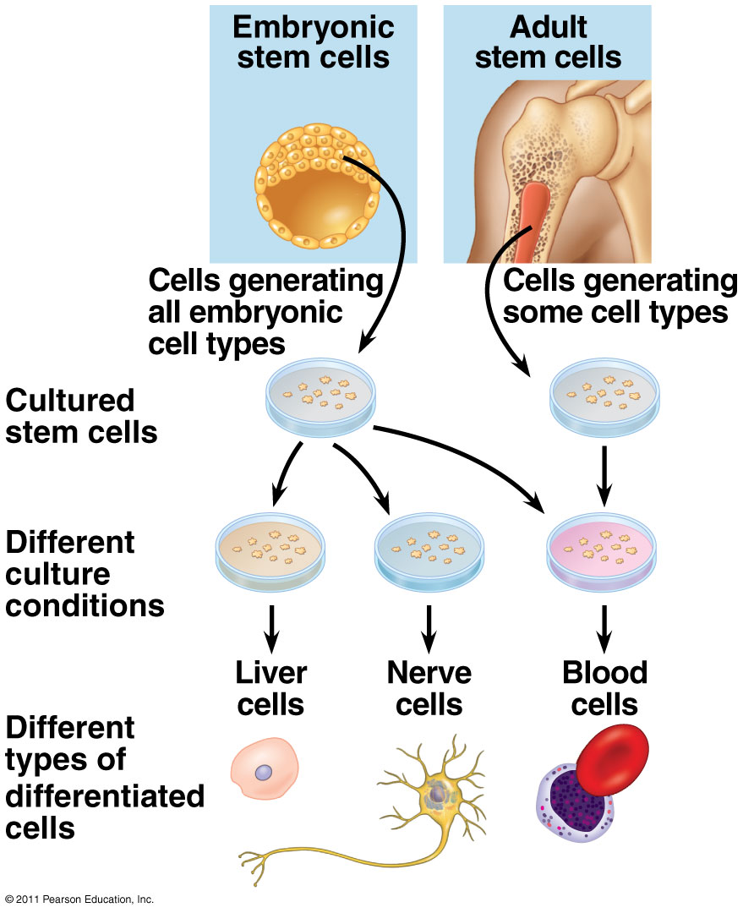
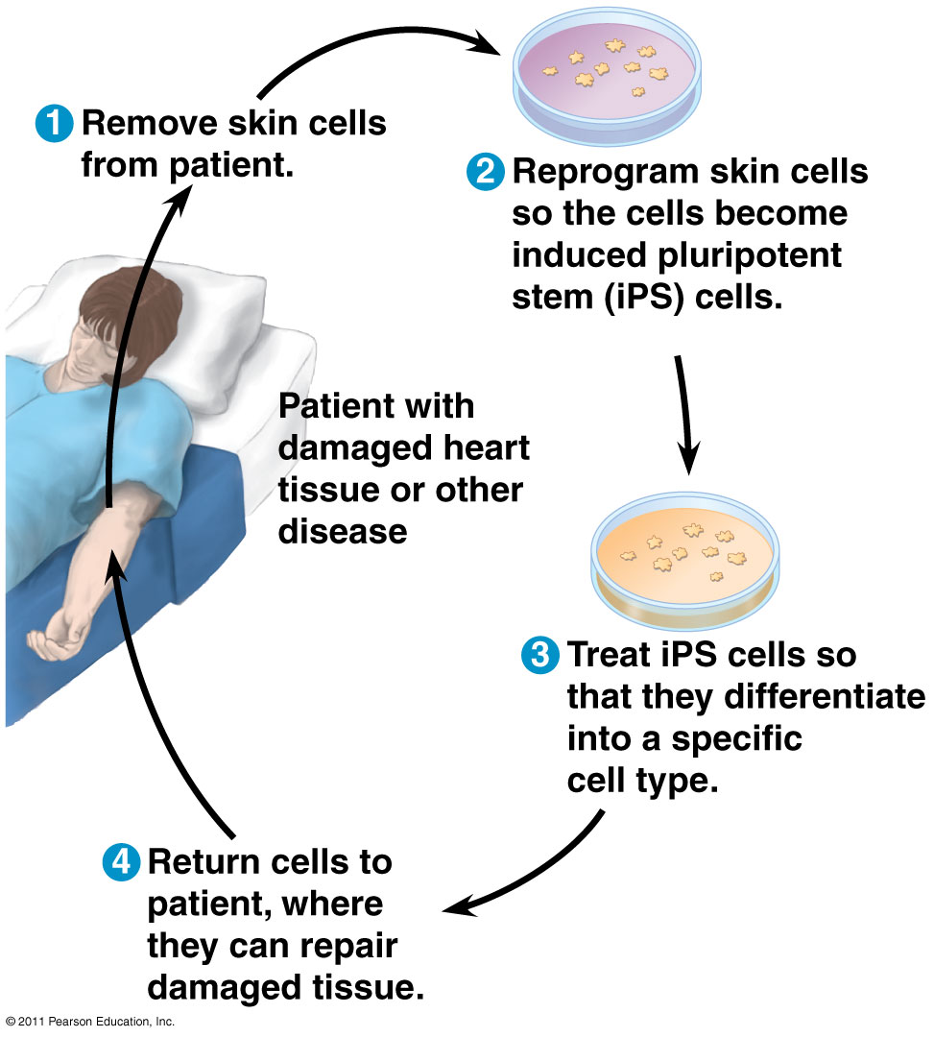
Embryonic vs. Adult stem cells
Using stem cells for disease treatment

Slide 28
Other techniques
CRISPER – nuclease that cuts DNA at a sequence it is directed to
  Use guide RNA molecule to direct
  Knock-out genes or insert genes
It is a molecule that finds a string of DNA code, locks on and makes a precision cut. And because scientists can tune it to target any genetic sequence, they can use it to turn genes off or replace them with new versions.
RNA interference (RNAi) – silence gene expression
  Analyze function of genes
Single nucleotide polymorphism (SNP) – a single base pair site where variation is found in at least 1% of the population
  Find genes that cause disorders, disease, and give specific treatment
  SNP is near a disease associated allele

Slide 29
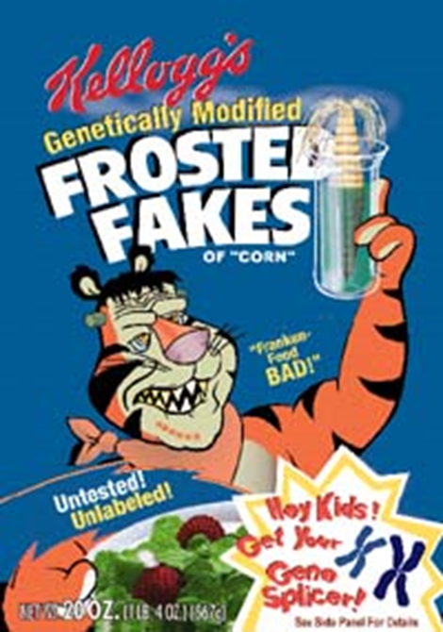
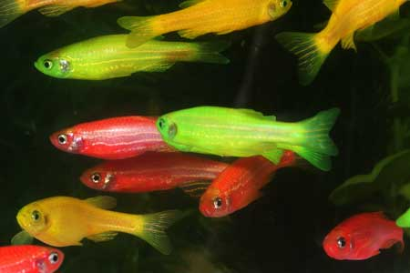
GMO
insertion of DNA from one organism into another OR modification of DNA in order to achieve a desired trait
Aka: transgenic organisms: contain functional recombinant DNA
GloFish: World’s First Transgenic Pet
Genes from jellyfish and coral give the GloFish their vivid colors

Slide 30
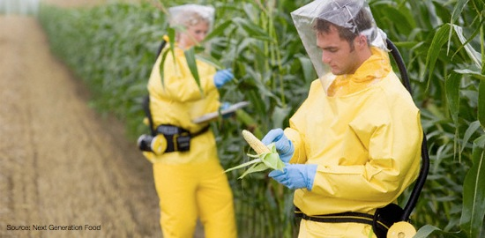
Common GM Foods
Products
**Corn
Canola
Potatoes
Tomatoes
Squash
**Soybeans
Flax
**Cotton
Sugarbeets
Experts say 60% to 70% of processed foods on U.S. grocery shelves have genetically modified ingredients.

Slide 31
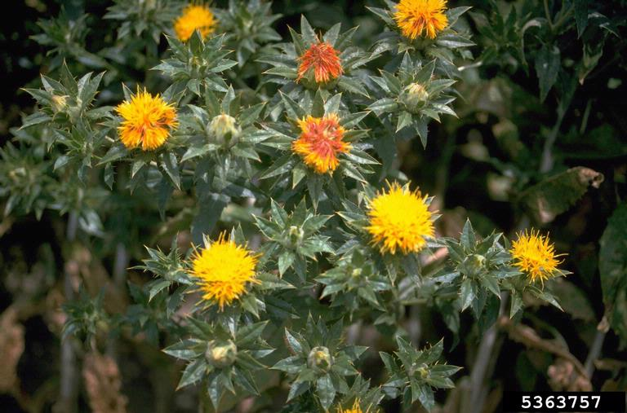
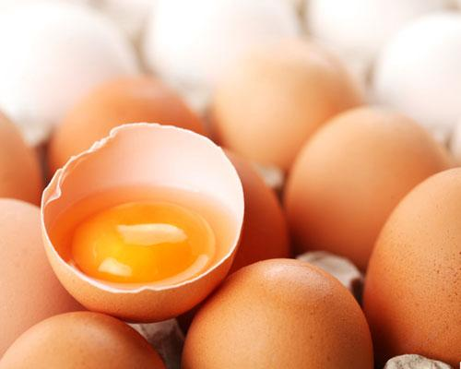
GMO in Medicine
Insulin (e.g., SemBioSys Genetics Inc- saflower)
Clotting factors
Atryn (anticoagulant).
Edible vaccines – some problems with dosage and immune tolerance.
Cancer fighting eggs- interferon Beta limited to some forms of malignant skin cancers and a few other diseases.

Slide 32
Some current uses of Farming
GMO Medicine
1. Mapp Biopharmaceutical, Inc. – Using tobacco plants to make components of Ebola vaccine ZMapp^{TM.}
2. Medicago – Making vaccines against viruses (e.g., influenza and HIV) using tobacco plants.
3. Ventria Bioscience – Making human lactoferrin (VEN 100) in rice as treatment against antibiotic-associated diarrhea.
4. Planet Biotechnology – Using plants to produce treatment of MERS coronavirus infection.

Slide 33

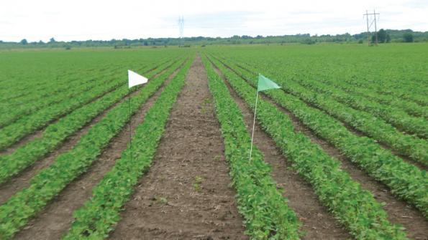
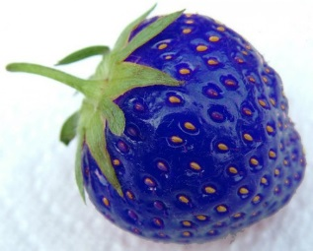
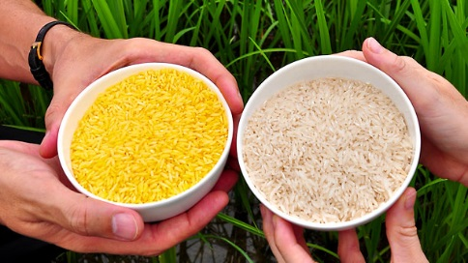
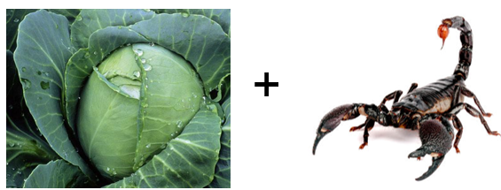
A.) Transgenic PLANTS
Disease-resistant and insect-resistant crops
B.t. crops – Bacillus thuringiensis bacteria make a toxin against insects – natural insecticide
Hardier fruit
Nutrient enhanced
Soybean
Roundup ready crops
Frost-free strawberry
Golden Rice
Kills caterpillars but not poisonous to humans
http://www.nature.com/cr/journal/v12/n2/full/7290120a.html

Slide 34

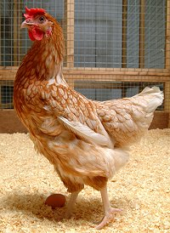
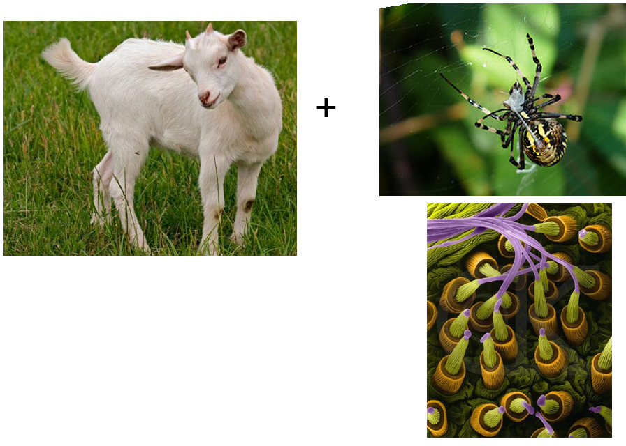
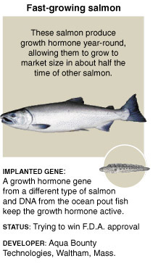
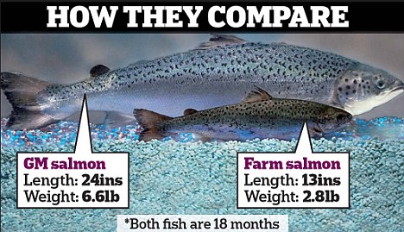
B. ) TRANSGENIC ANIMALS
Fast Growing Foods
Chickens – more resistant to infections (Bird Flu)
Cows – increase milk supply and leaner meat, less methane
Goats, sheep and pigs – produce human proteins in their milk, biosteel

Slide 35
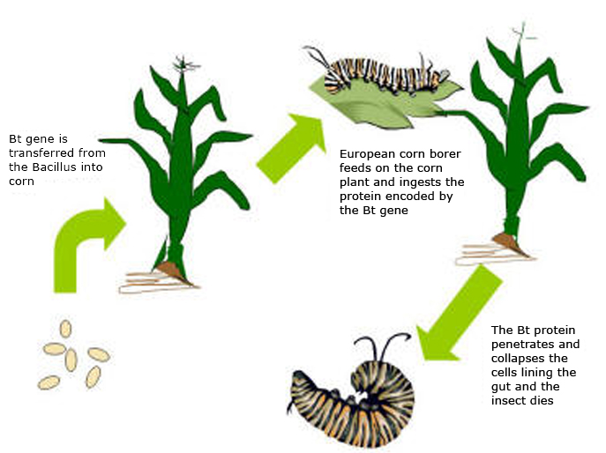
Bt crops

Slide 36
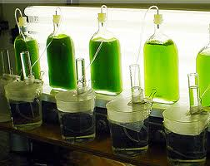
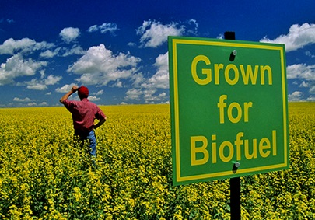
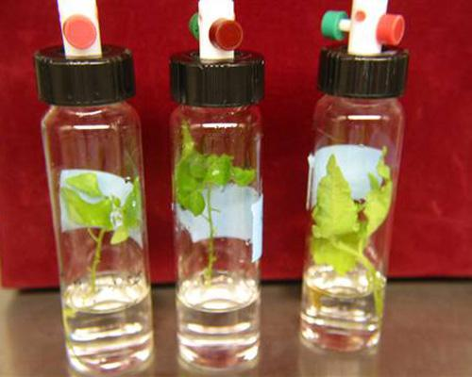
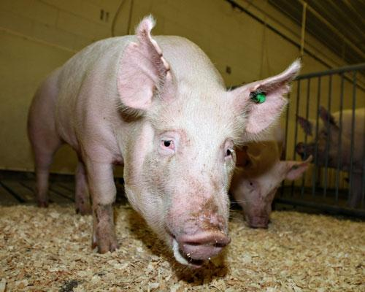
Other uses of GMO’s
Biofuels
Bioremediation
Rapeseed (i.e., canola)
Algenol Biofuels
Enviropig i.e., “Frankenswine”
Poplar trees remove groundwater contaminants
Able to digest and process phosphate

Slide 37
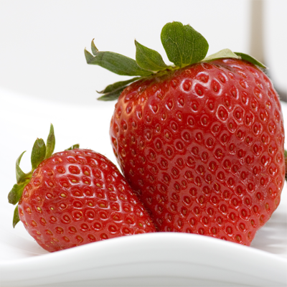
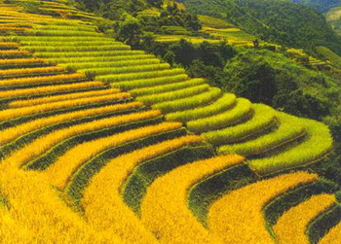
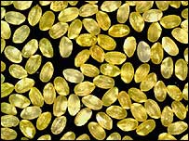
Advantages of GM
virus, disease tolerance; so the plants grow better.
Higher yield: We can also grow crops in areas that were once inhospitable to plant growth.
Nutrient enhancement
      Beta carotene (vitamin A) added to rice (golden rice) used to fight malnutrition world wide.
Food security
  Drought/cold Resistance
  Increase Shelf life increases
Ice minus strawberries
Golden rice

Slide 38
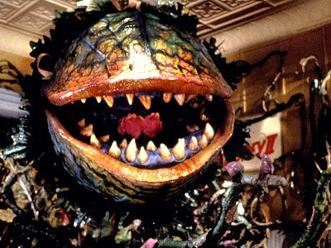
Disadvantages
Allergies and immunity to vaccines etc.
Gene transfer
Out-crossing/Accidental cross pollination
Super weeds
Contaminating streams
Biodiversity issues
Ownership of genes

Slide 39
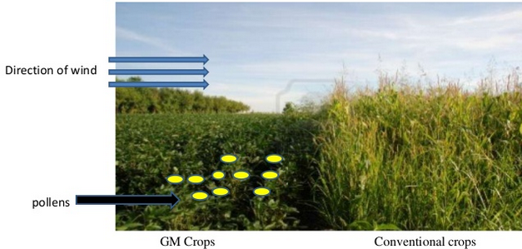
Out-crossing
Movement of genes from GM plants into conventional crops
Mixing crops from conventional seeds with those grown using GM crops
  Monsanto Lawsuits

Slide 40
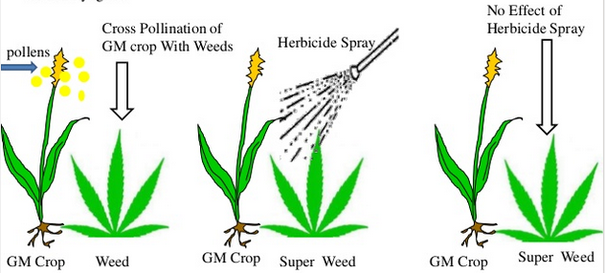
Super Weeds
A wild plant that has been pollinated by GM plant and contains resistance
Certain invasive grasses are resistant
  Common ragwed, italian ryegrass

Slide 41
Biotechnology PROS
Disease resistant crops
New vaccines & medications (insulin, human growth hormone)
Bigger livestock- more meat, milk, wool etc.
Possible cures for diseases
Environmentally friendly organisms (envio-pig, less methane producing cows, etc)

Slide 42
Biotechnology Cons:
Unpredictable – technology is new & no guarantee that products free of side affects
Money- companies patent genes & demand high prices
Unexpected impacts on the environment
Biological weapons
Concerns over the safety and ethics of incorporating GMO’s into food for human consumption
  Allergens

Slide 43
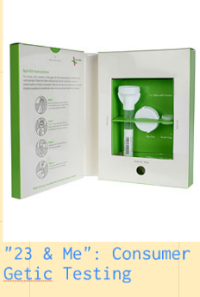
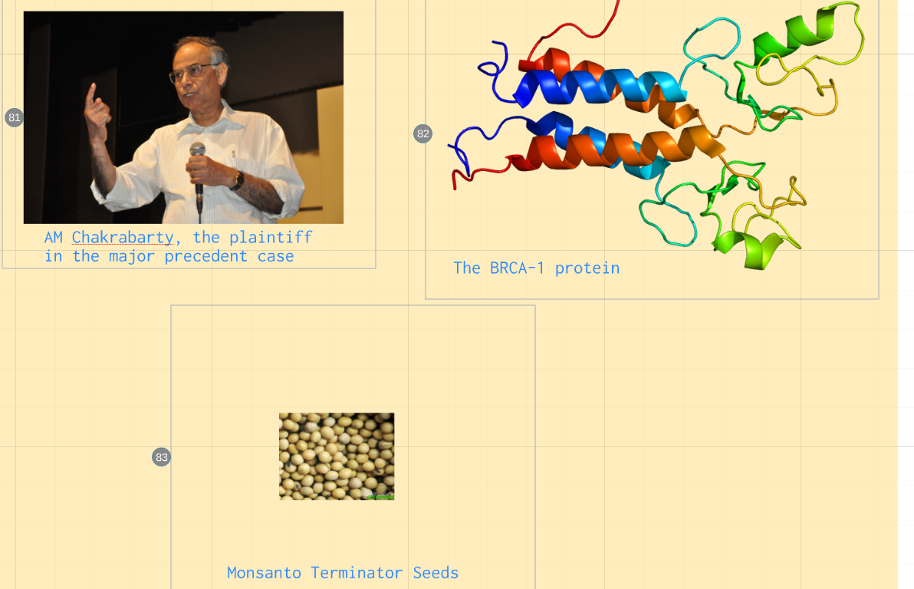
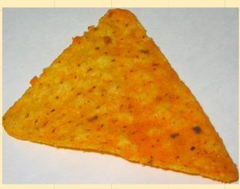
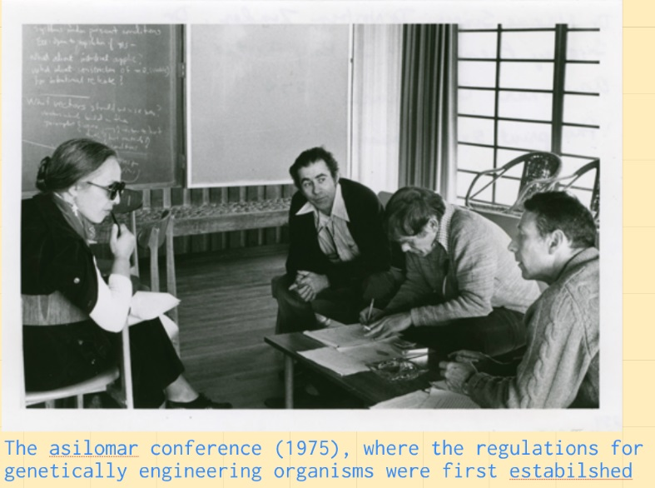

Ethics
How much do we have a right to know?
How much do other folks have a right to know about us?
Ownership of genes: Can a gene be owned? An organism?
Monsanto Terminator Seed
GMO’s

